Slide 1

Introduction to web technologies
HTML + CSS + Javascript
Odedara Ashish Rambhai(21BCS1919)

Slide 2
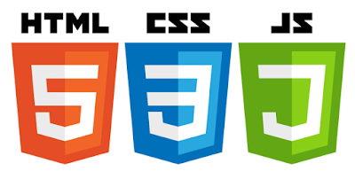
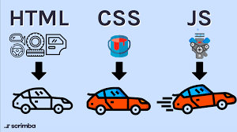
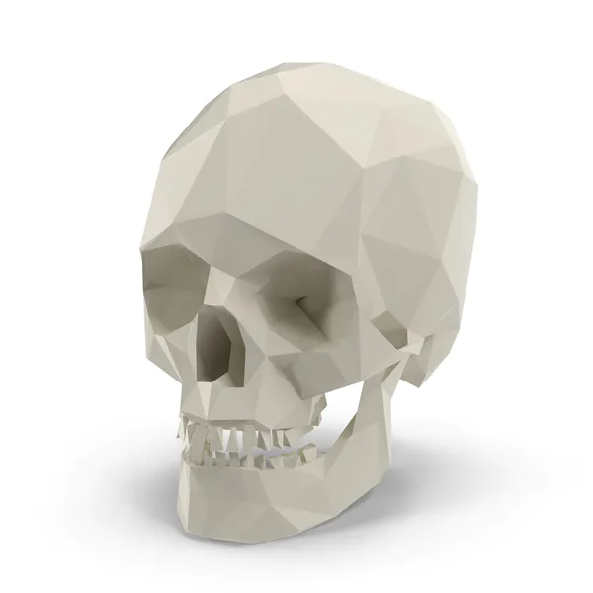


Goals
Introduction to web technologies:
HTML to create the document structure and content
CSS to control is visual aspect
Javascript for interactivity

Slide 3


Technologies
HTML
CSS
Javascript

Slide 4
HTML: main tags
Although there are lots of tags in the HTML specification, 99% of the webs use a subset of HTML tags with less that 9 tags, the most important are:
<div>: a container, usually represents a rectangular area with information inside.
<img/>: an image
<a>: a clickable link to go to another URL
<p>: a text paragraph
<h1>: a title (h2,h3,h4 are titles of less importance)
<input>: a widget to let the user introduce information
<style>: to insert CSS rules
<script>: to execute Javascript
<span>: a null tag (doesn't do anything)

Slide 5

Technologies
HTML
CSS
Javascript

Slide 6
CSS fields
Here is a list of the most common CSS fields and an example:
color: #FF0000; red; rgba(255,00,100,1.0); //different ways to specify colors
background-color: red;
background-image: url('file.png');
font: 18px 'Tahoma';
border: 2px solid black;
border-top: 2px solid red;
border-radius: 2px; //to remove corners and make them more round
margin: 10px; //distance from the border to the outer elements
padding: 2px; //distance from the border to the inner elements
width: 100%; 300px; 1.3em; //many different ways to specify distances
height: 200px;
text-align: center;
box-shadow: 3px 3px 5px black;
cursor: pointer;
display: inline-block;
overflow: hidden;

Slide 7


Technologies
HTML
CSS
Javascript

Slide 8
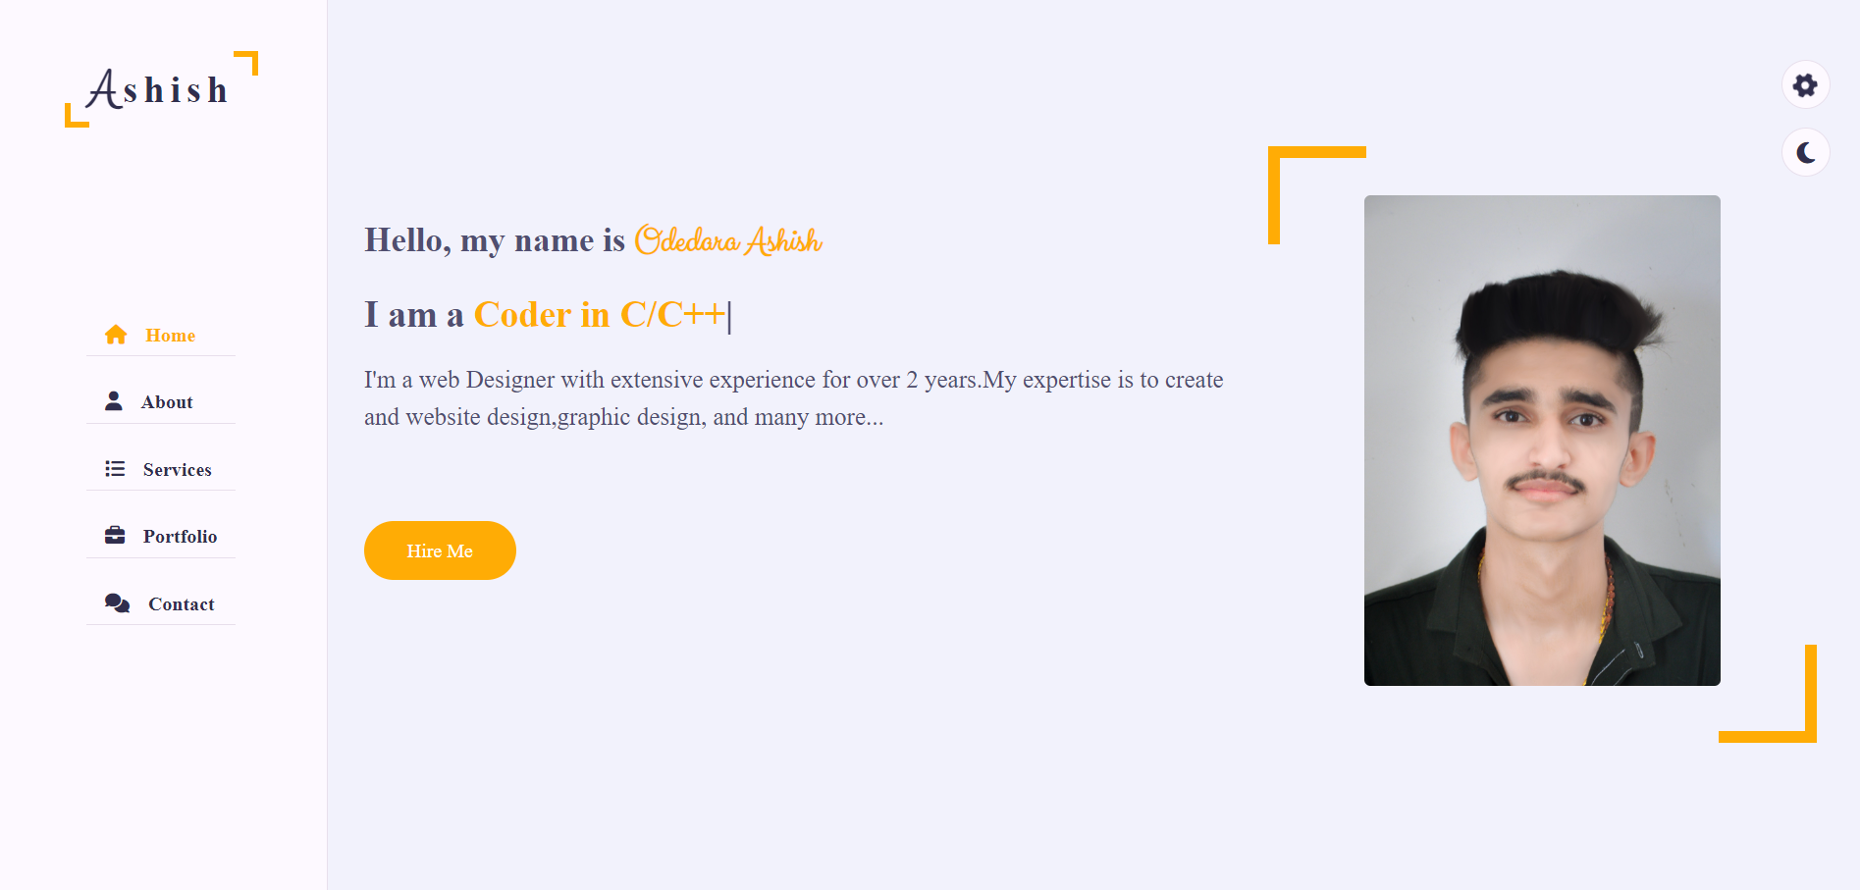
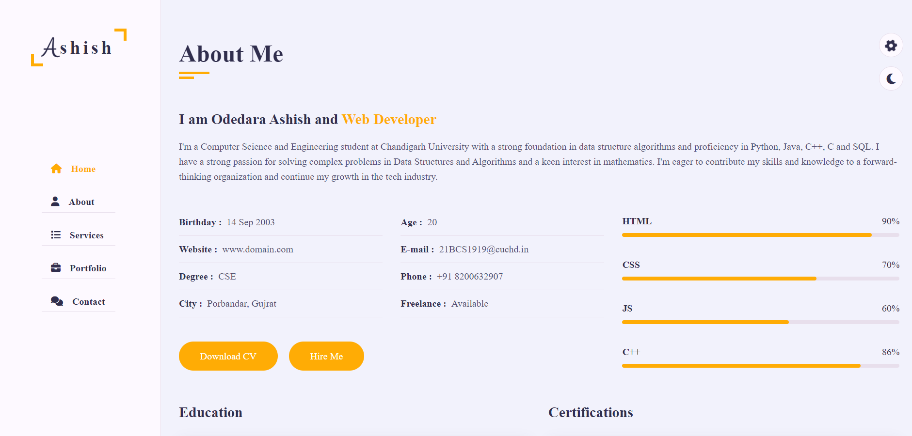


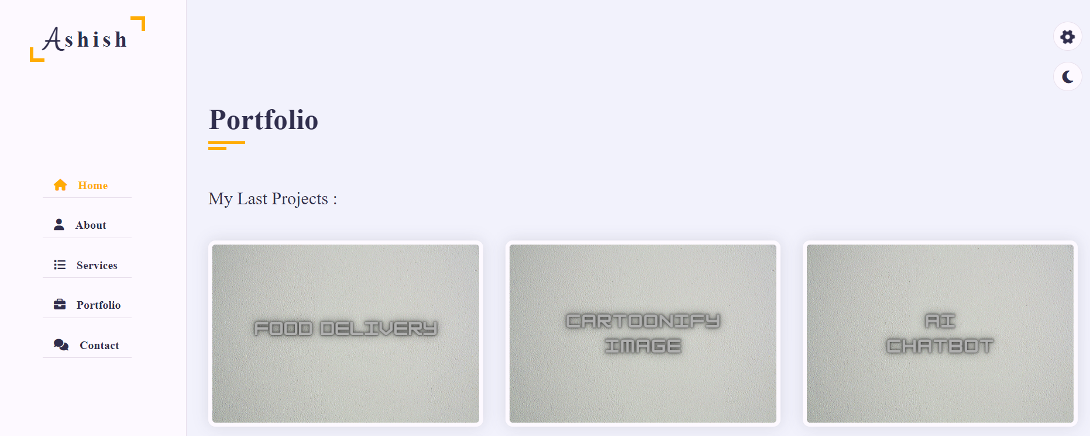
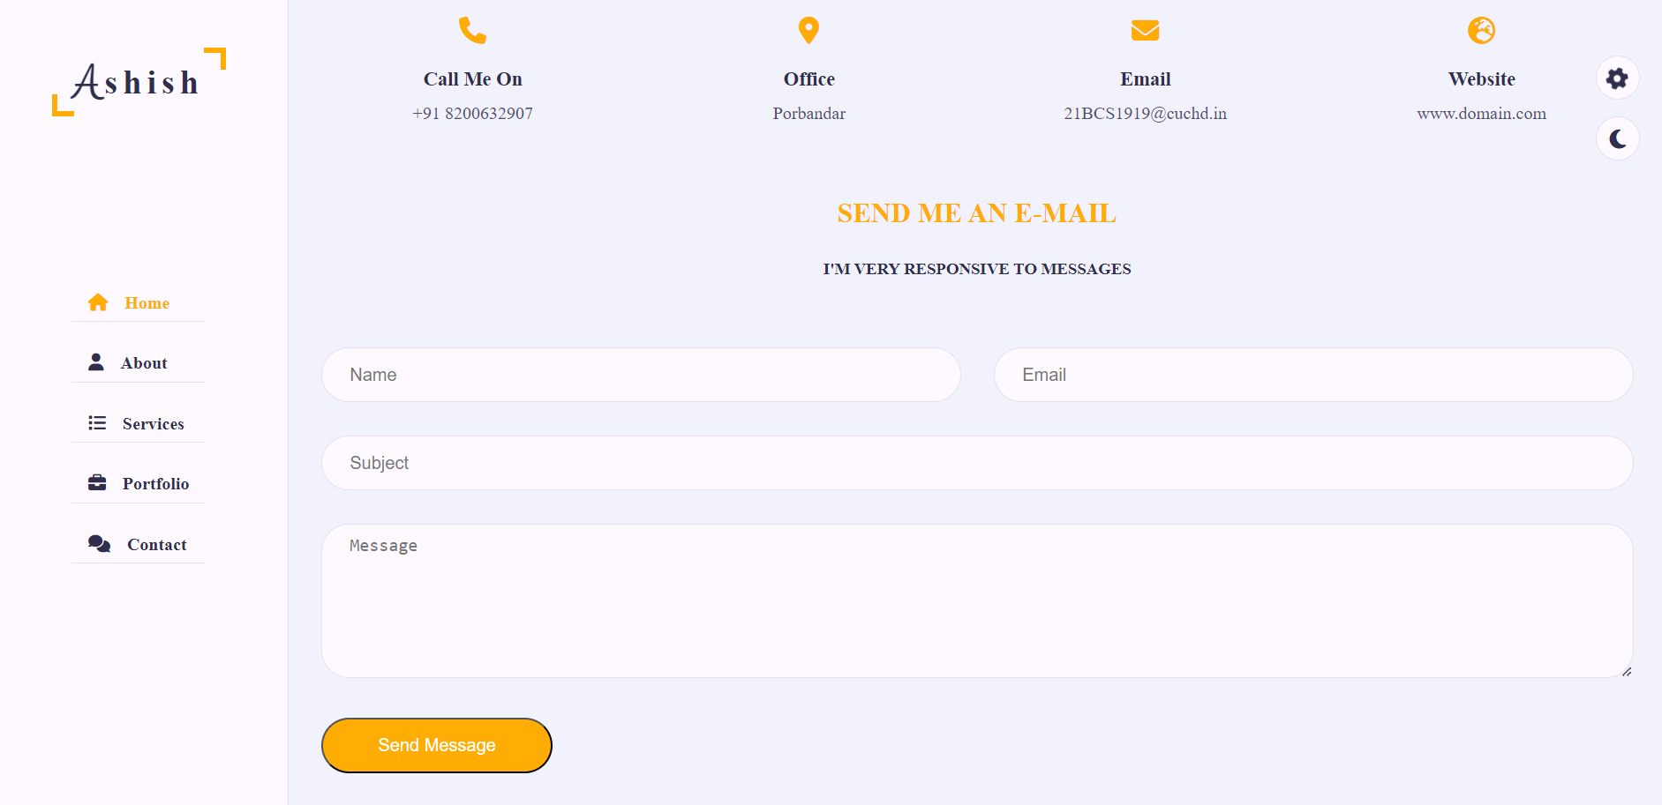
My Project
Click Me => file:///D:/Project/Portfolio/index.html

Slide 9
THANK YOU

